Slide 1

Logistics Optimization for Delivery Routes – UPS
Queries and Results

Slide 2
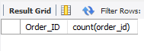
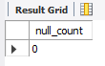
Task 1: Data Cleaning & Preparation
Identify and delete duplicate Order_ID records :
Select Order_ID, count(order_id) from orders group by order_id having count(Order_ID) > 1;
To check the null values in Routes table in Traffic_Delay_Min :
Select count(*) as null_count from routes where Traffic_Delay_Min is null;

Slide 3
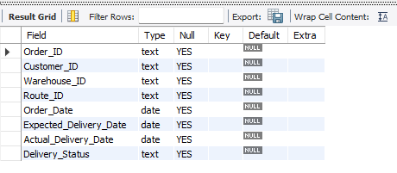
Task 1: Data Cleaning & Preparation
Convert all date columns into YYYY-MM-DD format using SQL functions.
Alter table orders Modify Order_Date date, Modify Expected_Delivery_Date date, modify Actual_Delivery_Date date;
UPDATE orders SET order_date = DATE_FORMAT (order_date,'%Y-%m-%d'), Expected_Delivery_Date = DATE_FORMAT (Expected_Delivery_Date,'%Y-%m-%d'), Actual_Delivery_Date = DATE_FORMAT(Actual_Delivery_Date,'%Y-%m-%d');

Slide 4
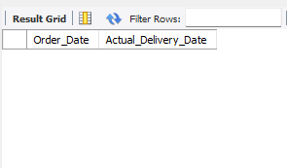
Task 1: Data Cleaning & Preparation
Ensure that no Actual_Delivery_Date is before Order_Date (flag such records).
Select Order_Date, Actual_Delivery_Date from Orders where Order_Date > Actual_Delivery_Date;

Slide 5
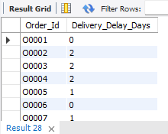
Task 2: Delivery Delay Analysis
Calculate delivery delay (in days) for each order
Select Order_Id, Actual_Delivery_Date - Expected_Delivery_Date as Delivery_Delay_Days from orders;

Slide 6
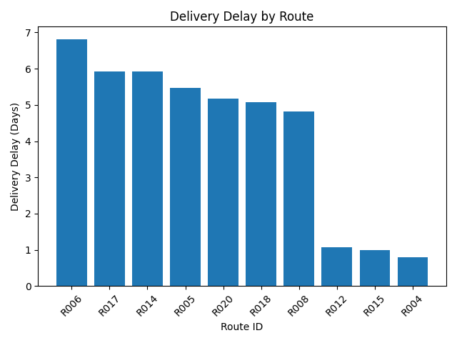
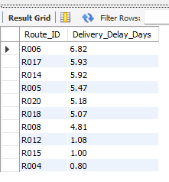
Task 2: Delivery Delay Analysis
Find Top 10 delayed routes based on average delay days.
SELECT Route_ID, ROUND (AVG (Actual_Delivery_Date -Expected_Delivery_Date), 2) AS Delivery_Delay_Days FROM orders GROUP BY Route_IDORDER BY Delivery_Delay_Days DESCLIMIT 10;

Slide 7
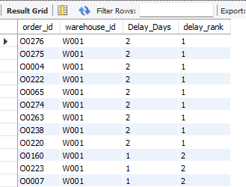
Task 2: Delivery Delay Analysis
Use window functions to rank all orders by delay within each warehouse.
Select order_id, warehouse_id, datediff (Actual_Delivery_Date,Expected_Delivery_Date) as Delay_Days,dense_rank() over ( partition by warehouse_id order by datediff (Actual_Delivery_Date,Expected_Delivery_Date) desc) as delay_rank from orders;

Slide 8
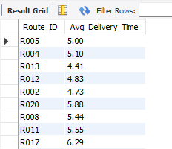
Task_3 Route Optimization Insights
For each route, calculate Average delivery time (in days).
SELECT Route_ID, ROUND (AVG (DATEDIFF (Actual_Delivery_Date, Order_Date)), 2) AS Avg_Delivery_Time FROM orders GROUP BY Route_Id;

Slide 9
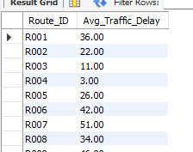
Task 3: Route Optimization Insights
For each route, calculate Average traffic delay.
Select Route_ID , round(avg(traffic_delay_min),2) as Avg_Traffic_Delay from routes group by Route_ID;

Slide 10
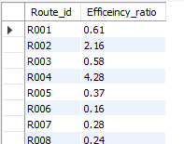
Task 3: Route Optimization Insights
For each route, calculate Distance-to-time efficiency ratio: Distance_KM / Average_Travel_Time_Min.
Select Route_id, Round(Distance_KM / Average_Travel_Time_Min,2) as Efficeincy_ratio from routes ;

Slide 11
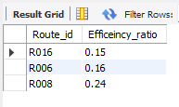
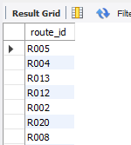
Task 3: Route Optimization Insights
Identify 3 routes with the worst efficiency ratio.
Select Route_id, Round(Distance_KM / Average_Travel_Time_Min,2) as Efficeincy_ratio from routes order by Efficeincy_ratio limit 3 ;
Find routes with >20% delayed shipments.
SELECT route_id FROM orders GROUP BY route_id HAVING AVG(CASE WHEN Actual_Delivery_Date > Expected_Delivery_Date THEN 1 ELSE 0END) > 0.20;

Slide 12

Task 3: Route Optimization Insights
Recommend potential routes for optimization :
Routes R006, R016, R008, R007, and R014 show the highest operational inefficiencies and delay impact and should be prioritized for logistics optimization initiatives.

Slide 13
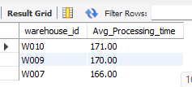
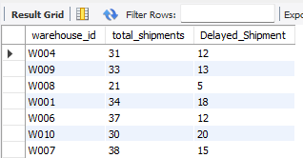
Task 4: Warehouse Performance
Find the top 3 warehouses with the highest average processing time.
SELECT warehouse_id, ROUND (AVG (Processing_Time_Min), 2) AS Avg_Processing_time FROM warehouses GROUP BY Warehouse_ID ORDER BY Avg_Processing_time DESC LIMIT 3;
Calculate total vs. delayed shipments for each warehouse.
SELECT warehouse_id, COUNT(*) AS total_shipments, SUM(CASE WHEN Actual_Delivery_Date > Expected_Delivery_Date THEN 1 ELSE 0 END) AS Delayed_Shipment FROM orders GROUP BY Warehouse_ID;

Slide 14
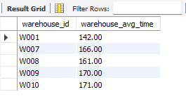

Task 4: Warehouse Performance
Use CTEs to find bottleneck warehouses where processing time > global average.
with global_average as ( select avg (processing_time_min) as avg_time from warehouses ) SELECT warehouse_id, ROUND(AVG(processing_time_min), 2) AS warehouse_avg_timeFROM warehouses, global_average GROUP BY Warehouse_ID , avg_time HAVING AVG (processing_time_min) > avg_time;

Slide 15
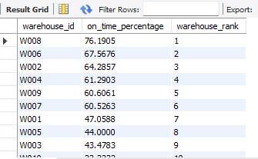
Task 4: Warehouse Performance
Rank warehouses based on on-time delivery percentage.
Select warehouse_id, on_time_percentage, rank() over( order by on_time_percentage desc) as warehouse_rank from ( select warehouse_id, 100 * avg( case when actual_delivery_date <= expected_delivery_date then 1 else 0 end) as on_time_percentage from orders group by Warehouse_ID) t;

Slide 16
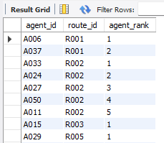
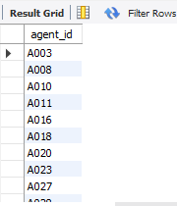
Task 5: Delivery Agent Performance
Rank agents (per route) by on-time delivery percentage
select agent_id, route_id, rank() over (partition by Route_ID order by on_time_percentage desc) as agent_rank from deliveryagents;
Find agents with on-time % < 80%.
Select agent_id from deliveryagents where on_time_percentage < 80 ;

Slide 17
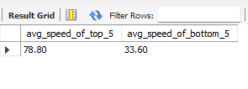
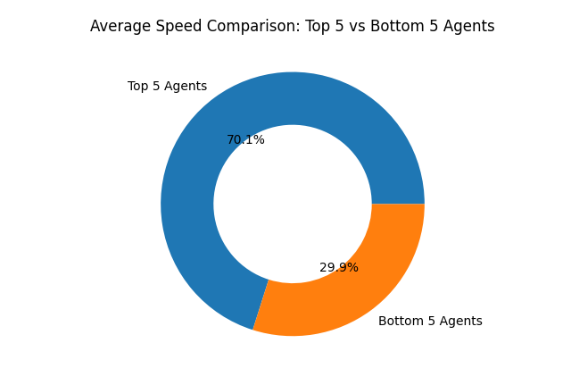
Task 5: Delivery Agent Performance
Compare average speed of top 5 vs bottom 5 agents using subqueries.
Select (Select round(avg(avg_speed_km_hr),2) from ( Select Avg_Speed_KM_HR from deliveryagents order by Avg_Speed_KM_HR desc limit 5) top_5 ) as avg_speed_of_top_5 , (Select round(avg(avg_speed_km_hr),2) from ( Select Avg_Speed_KM_HR from deliveryagents order by Avg_Speed_KM_HR asc limit 5) bottom_5 ) as avg_speed_of_bottom_5;

Slide 18
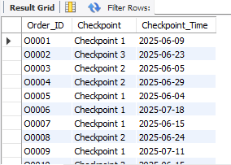
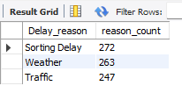
Task 6: Shipment Tracking Analytics
For each order, list the last checkpoint and time.
Select Order_ID, Checkpoint, Checkpoint_Time from(Select order_id, checkpoint, checkpoint_time, row_number() over ( partition by order_id order by str_to_date(checkpoint_time,'%Y-%m-%d %H:%i:%s') desc) as rn from shipment_tracking) t where rn = 1;
Find the most common delay reasons (excluding None).
SELECT Delay_reason, COUNT(*) AS reason_count FROM shipment_tracking WHERE Delay_Reason IS NOT NULL AND Delay_Reason <> 'None'GROUP BY Delay_ReasonORDER BY reason_count DESC;

Slide 19
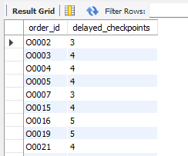
Task 6: Shipment Tracking Analytics
Identify orders with >2 delayed checkpoints
SELECT order_id, COUNT(*) AS delayed_checkpoints FROM shipment_tracking WHERE Delay_Reason IS NOT NULL AND Delay_Reason <> 'None'GROUP BY Order_IDHAVING COUNT(*) > 2;

Slide 20
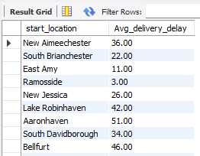
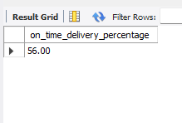
Task 7: Advanced KPI Reporting
Average Delivery Delay per Region (Start_Location).
Select start_location, round(avg(traffic_delay_min),2) as Avg_delivery_delay from routes group by Start_Location;
On-Time Delivery % = (Total On-Time Deliveries / Total Deliveries) * 100
SELECT ROUND(SUM(CASE WHEN actual_delivery_date <= expected_delivery_date THEN 1 ELSE 0 END) / COUNT(order_id) * 100, 2) AS on_time_delivery_percentageFROM orders;

Slide 21
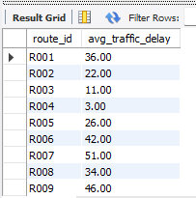
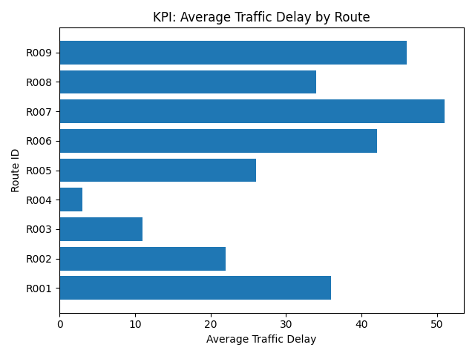
Task 7: Advanced KPI Reporting
Average Traffic Delay per Route.
Select route_id, round(avg(traffic_delay_min),2) as avg_traffic_delay from routes group by Route_ID;

Slide 22
Thank You
Kapil

